Slide 1
PREDICTION OF FOREST FIRES
DATA 621: BUSINESS ANALYTICS AND DATA MINING FINAL COURSE PROJECT PRESNETATION
Critical thinking group #4
devin teran, aTINA KARIM, AMIT KAPOOR, THOMAS HILL

Slide 2
OBJECTIVES
Identify real-world dataset
Define a problem to study using data
Review relevant literature, regression methodologies
Measure outcomes

Slide 3
PROBLEM STATEMENT
What factors contribute to the size and risk of forest fires?
Seasonal effects
Temporal/spatial information
Meteorological data
Established indices of fire risk
Benefits of prediction
Prevent loss of life and environmental damage
Allocate fire suppression resources over larger area
Use available meteorological forecasts to predict fire risk
Avoid need for specialized equipment (smoke detectors, air surveillance)

Slide 4
BACKGROUND
Original dataset complied by Cortez et al
Natural park in mountainous northeast Portugal
Fire date, location, and area, weather data,
Canadian Fire Weather Index (FWI) codes
N = 517 fires over ~3 years
Model to predict location of small fires built on SVM techinques
Cortez, Paulo & Morais, A. (2007). A Data Mining Approach to Predict Forest Fires using Meteorological Data.

Slide 5
LITERATURE REVIEW: PORTUGUESE DATASET
Shidik et al:
Hybrid model using clustering then classification
Initial clustering using fuzzy C-means (FCM) for existing variables
Light burn, heavy burn, versus no burn area
Back-propogation neural network to predict class membership
Other techniques considered: SVM, NB, DCT trees, KNN
Categorical outcomes allowed for confusion matrix for measuring performance
Shidik G.F., Mustofa K. (2014) Predicting Size of Forest Fire Using Hybrid Model. In: Linawati, Mahendra M.S., Neuhold E.J., Tjoa A.M., You I. (eds) Information and Communication Technology. ICT-EurAsia 2014. Lecture Notes in Computer Science, vol 8407.

Slide 6
LITERATURE REVIEW: OTHER DATASETS
Stanford-Moore et al:
US dataset, 1992 – 2015, N = 1.88M fires
Random sample of 4000 considered
Response variable: binned fire size
Techniques: SVM, neural networks, KNN, decision trees, linear regression
Performance: mean absolute error and percent error
Stanford-Moore, A., Moore, B. (n.d.). Wildfire Burn Area Prediction. http://cs229.stanford.edu/proj2019aut/data/assignment_308832_raw/26582553.pdf

Slide 7
LITERATURE REVIEW: OTHER DATASETS
Maffei et al:
N = 9127 fires between 2002 – 2011 in Italy
Also uses FWI codes
Concentrates on predicting fuel moisture
Perpindicular moisture index (PMI)
Inversely proportional to extreme events
Coffield et al:
N = 1168 fires in Alaska, 2001 – 2017 for months May – August
Decision tree classification
'small', 'medium', 'large'
Carmine Maffei, Massimo Menenti. Predicting forest fires burned area and rate of spread from pre-fire multispectral satellite measurements, ISPRS Journal of Photogrammetry and Remote Sensing,Volume 158, 2019,Pages 263-278.
Coffield, SR, Graff, CA, Chen, Y., Smyth, P., Foufoula-Georgiou, E., & Randerson, JT. (2019). Machine learning to predict final fire size at the time of ignition. International Journal of Wildland Fire, 28(11), 861-873.

Slide 8
PROJECT METHODOLOGY
Visualization of explanatory variables
Detection of outliers, missing data
Transformations and dummy variables for seasonal features
Model selection and performance

Slide 9
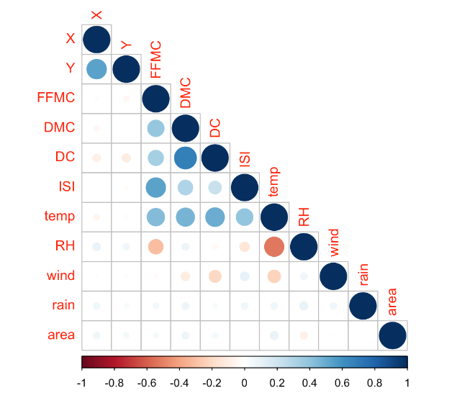
DATA EXPLORATION: NUMERIC
Temperature collinear with several FWI codes
Climate: humidity strongly negative correlated with temp
No strong correlations with area response variable
Not mentioned: day and month variables

Slide 10
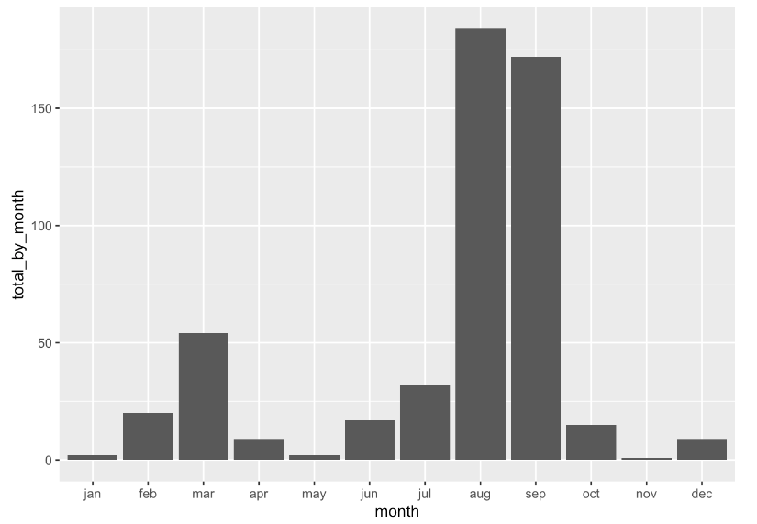
DATA EXPLORATION: TIME SERIES
Most fires ID'ed during August and September
Unexpected uptick in reporting in the month of March
Not pictured: no significant pattern for day of week

Slide 11
MISSING VALUES
Study period: January 2000 – December 2003
However, only 517 observations
Original dataset does not offer observations for 'null' case
Time series data only gives month and day of week
Unable to ID clusters of fire reports
Some obsevations have entry of 'zero' for area of fire

Slide 12
MODEL SELECTION
All observatiosn vs keep only with area > 0
Shrinkage methods:
StepAIC()
Leaps package
Comparison of model versus robust regression
RSE as metric

Slide 13
CONCLUSIONS
The most significant predictor of larget forest fires (in terms of forest fires) is the Duff Moisture Code Index
DMC: a numeric rating of the average moisture content of loosely compacted organic layers of moderate depth
Large forest fires may also be likely to occur during the months of December and October in this region, but weak negative relationship between large forest fires for August.
Fire size?

